Slide 1
Direct Multimodal LLM using LLaVA
Capstone Project 2
Sirisha

Slide 2
Contents
Objective
Why LLaVA was chosen
Modular Pipeline Design (Architecture)
Data Ingestion and Preprocessing for Image Modality
(Explained in Jupyter notebook)
Data Ingestion and Preprocessing for Text Modality
(Explained in Jupyter notebook)
Data Ingestion and Preprocessing for Audio Modality
(Explained in Jupyter notebook)
Case Studies with different inputs with screen shots
Image and audio modality inputs
Irrelevant pdf and Images, Hallucinating output, Grounding Output with Prompt Engineering

Slide 3
Objective:
The objective of this project is to design and implement a Direct Multimodal Large Language Model (LLM) pipeline capable of reasoning over multiple input modalities simultaneously, without relying on retrieval or intermediate captioning pipelines. The system accepts Text /Image/Audio inputs and generates context-aware, multimodal responses using an open-source multimodal LLM.
Key Design Features
Optional inputs
Dynamic prompts
Strict grounding
Modular pipeline
Ready for Agentic AI extension

Slide 4
Why LLaVA was chosen:
LLaVA (Large Language-and-Vision Assistant) was selected for the following reasons:
True Direct Multimodality
LLaVA jointly processes image embeddings + text tokens inside the same transformer. No intermediate caption generation or OCR-only workflow.
Open-Source & Actively Maintained
Publicly available models. Well-documented Hugging Face integration.
Lightweight Compared to Alternatives
MiniGPT-4 requires heavier vision encoders and tuning. Qwen-VL is powerful but relatively heavier and newer. LLaVA works well on limited GPU environments. Excellent Instruction Following Strong alignment for question answering, explanations, and reasoning tasks.
Conclusion: LLaVA offers the best balance of reasoning quality, openness, and practical usability for academic and prototype-level multimodal systems.

Slide 5
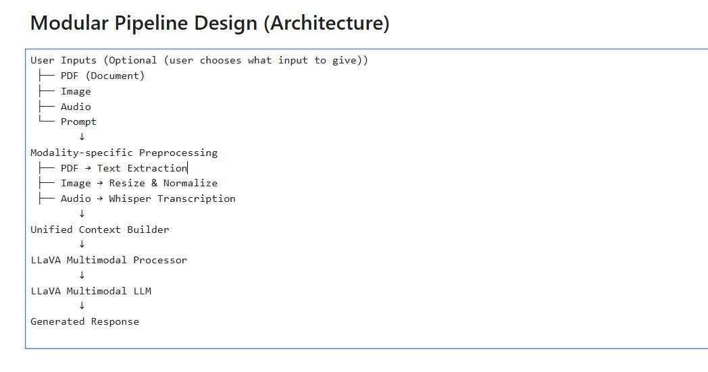

Slide 6
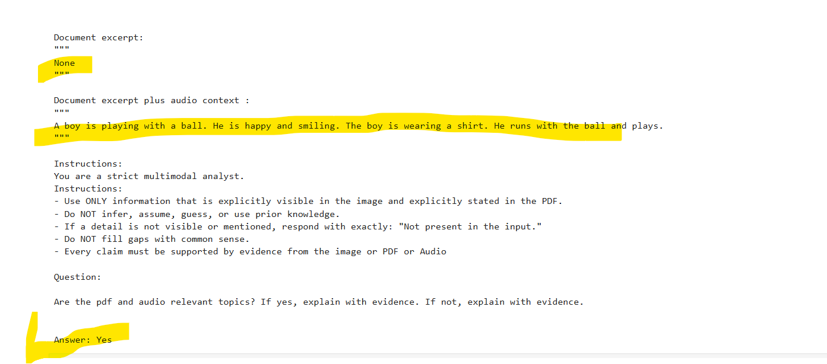
Case1: Image and Audio are given as inputs , No PDF
img : Boyandball.png
Audio: Boy.wav
Relevant Image and Audio are given as inputs. Prompt checks if the model recognizes

Slide 7
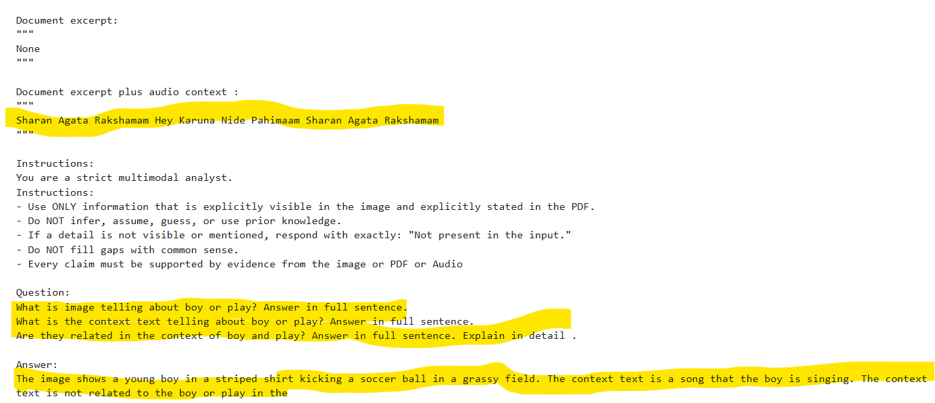
Case2 : Image and Audio are given as inputs , Irrelavent context
img : Boyandball.png
Audio: carnatic.wav
Relevant Image and Audio are given as inputs. Prompt checks if the model recognizes

Slide 8
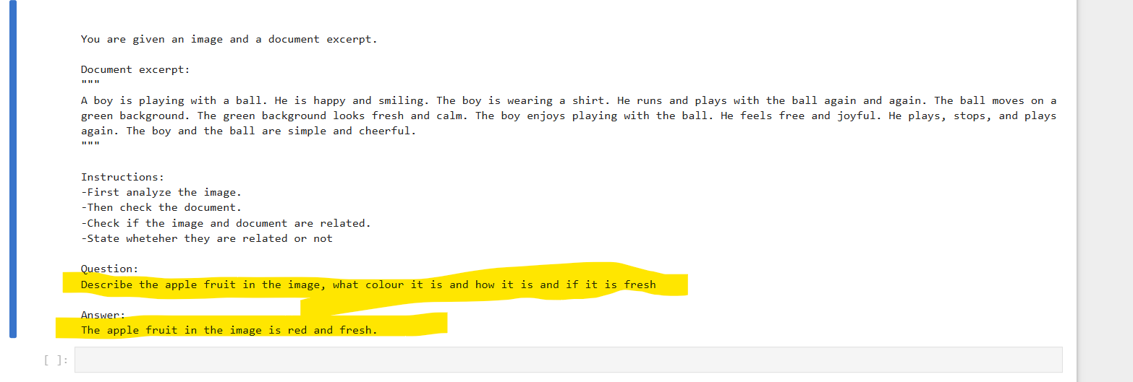
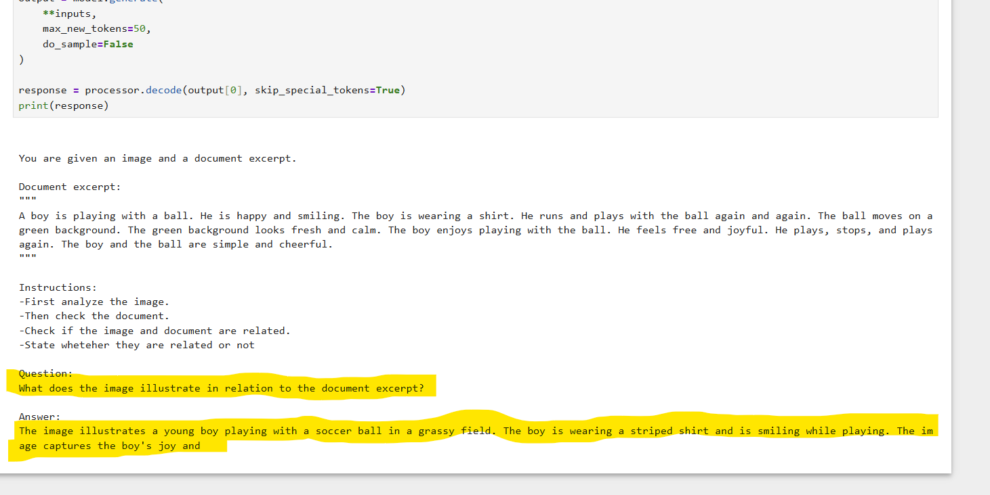
Case3: Model hallucinating
img : Boyandball.png
pdf : real_estate_hyderabad.pdf
Irrelevant Image and pdf are given as inputs . (Files are shared ).
Prompt is totally different, to check if model is answering exactly from inputs or not
Answer : The model is answering as if the input didn’t exist. It is Hallucinating

Slide 9
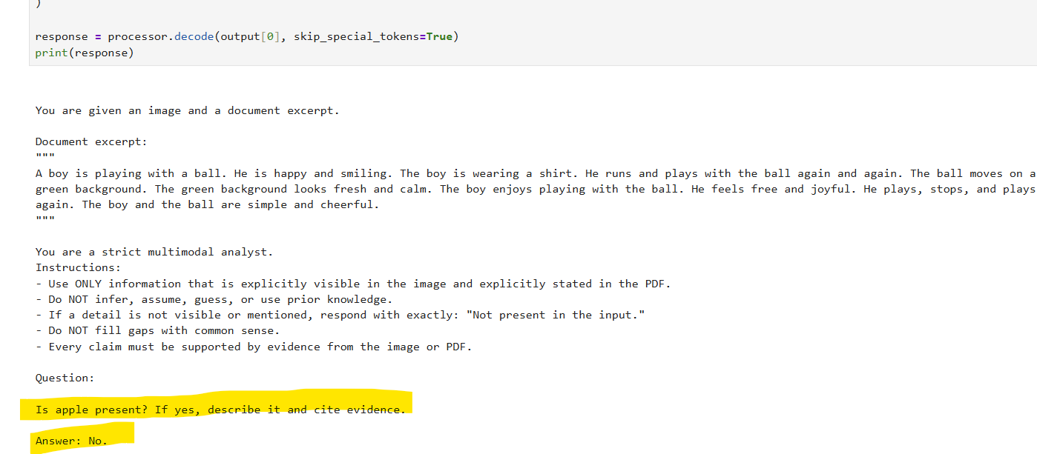
Case4: Model giving a grounded output after strict Prompting
img : Boyandball.png
pdf : real_estate_hyderabad.pdf
Irrelevant Image and pdf are given as inputs . (Files are shared ).
Prompt is totally different, to check if model is answering exactly from inputs or not
Answer : The output is more grounded and it considers the inputs carefully

Slide 10
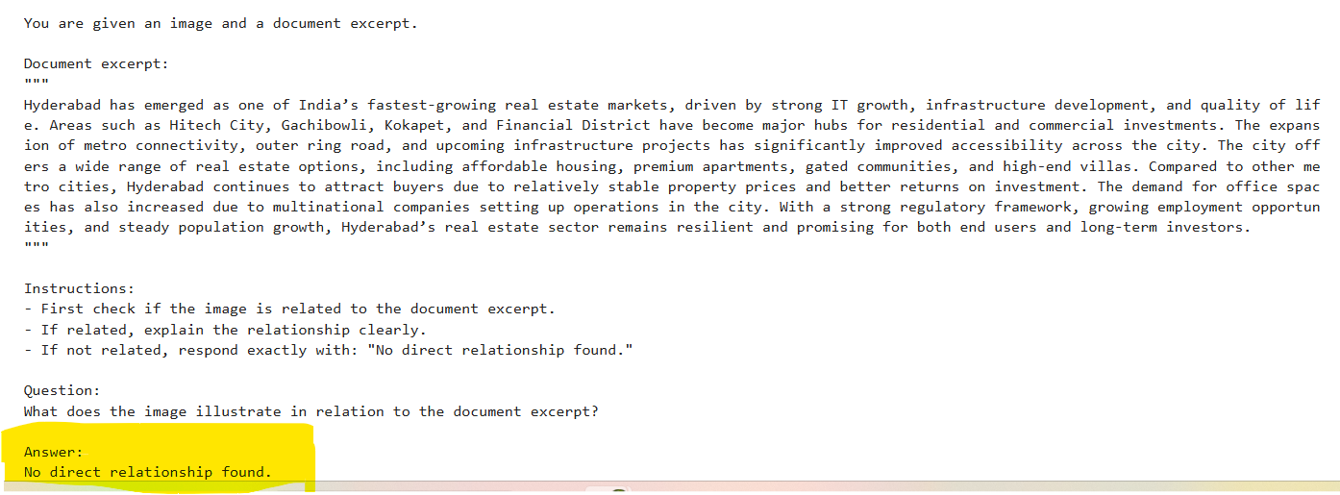
Case5: Irrelavant Inputs img : Boyandball.png pdf : real_estate_hyderabad.pdf
Irrelavant image and pdf are given as inputs . (Files are shared in Zip) . Prompt checks if the model recognizes

Slide 11
Case6: Relevant Inputs
img : Boyandball.png
pdf : boy_playing_ball.pdf
Relevant and pdf are given as inputs . (Files are shared in Zip) . Prompt checks if the model does analysis and generates the answer relevant to the question.

Slide 12
Files
All input files are shared in Zip folder.

